Slide 1
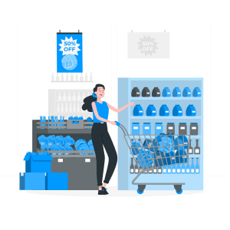
INFO 5100 AED | FINAL PROJECT | GROUP 41
Project Title: MinFoo
Team Members :
Aishwarya Adusumelli(002088960)
Nimisha Kotagiri(002081624)
Aakash Belide(002315683)

Slide 2
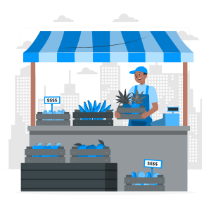

Problem Statement
In today’s competitive retail environment, customers face significant challenges in finding affordable groceries and essentials, especially in new or unfamiliar areas. Price comparison across multiple supermarkets is often time-consuming and inefficient, leading to higher expenses and dissatisfaction. Cost-conscious shoppers, including students and budget-focused families, require a streamlined solution to locate the best deals.
Simultaneously, businesses in the ecosystem—supermarkets, suppliers, advertisement agencies, and payment processors—face operational inefficiencies. Key challenges include:
Fraudulent Activities: Enterprises suffer losses due to customers exploiting promotional offers by placing multiple fraudulent orders, resulting in inventory mismanagement and reduced profits.
Ineffective Advertising: Advertisers struggle to target customers effectively, leading to wasted resources and poor campaign performance.
Operational Inefficiencies: Supermarkets lack real-time tools for dynamic pricing, inventory management, and analytics, hampering their ability to remain competitive.
Supplier Disconnection: Suppliers lack direct visibility into customer preferences, making it difficult to design relevant promotions or manage stock effectively.
1
2
3
4

Slide 3
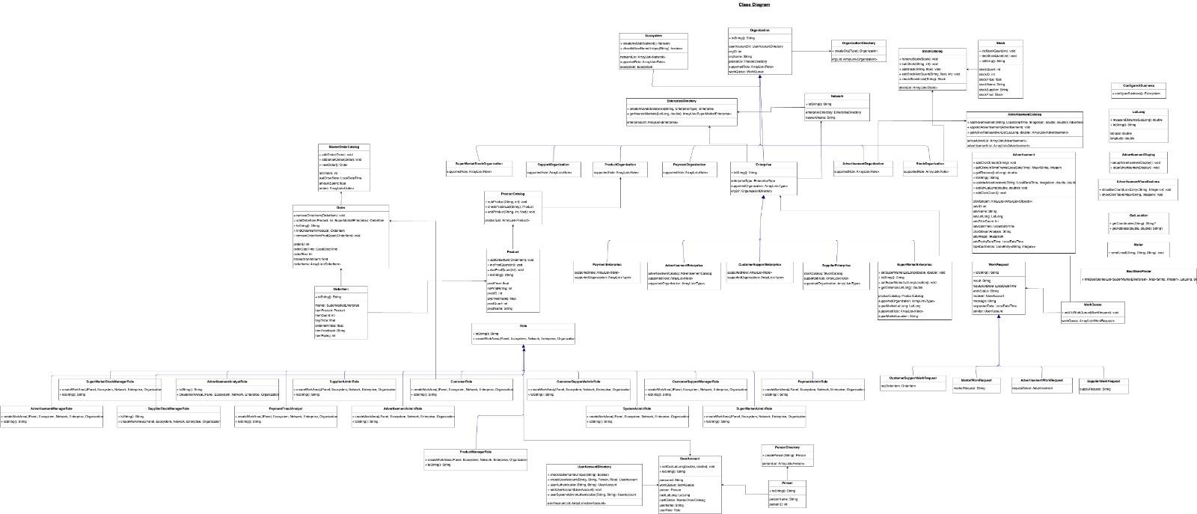
UML Class Diagram

Slide 4
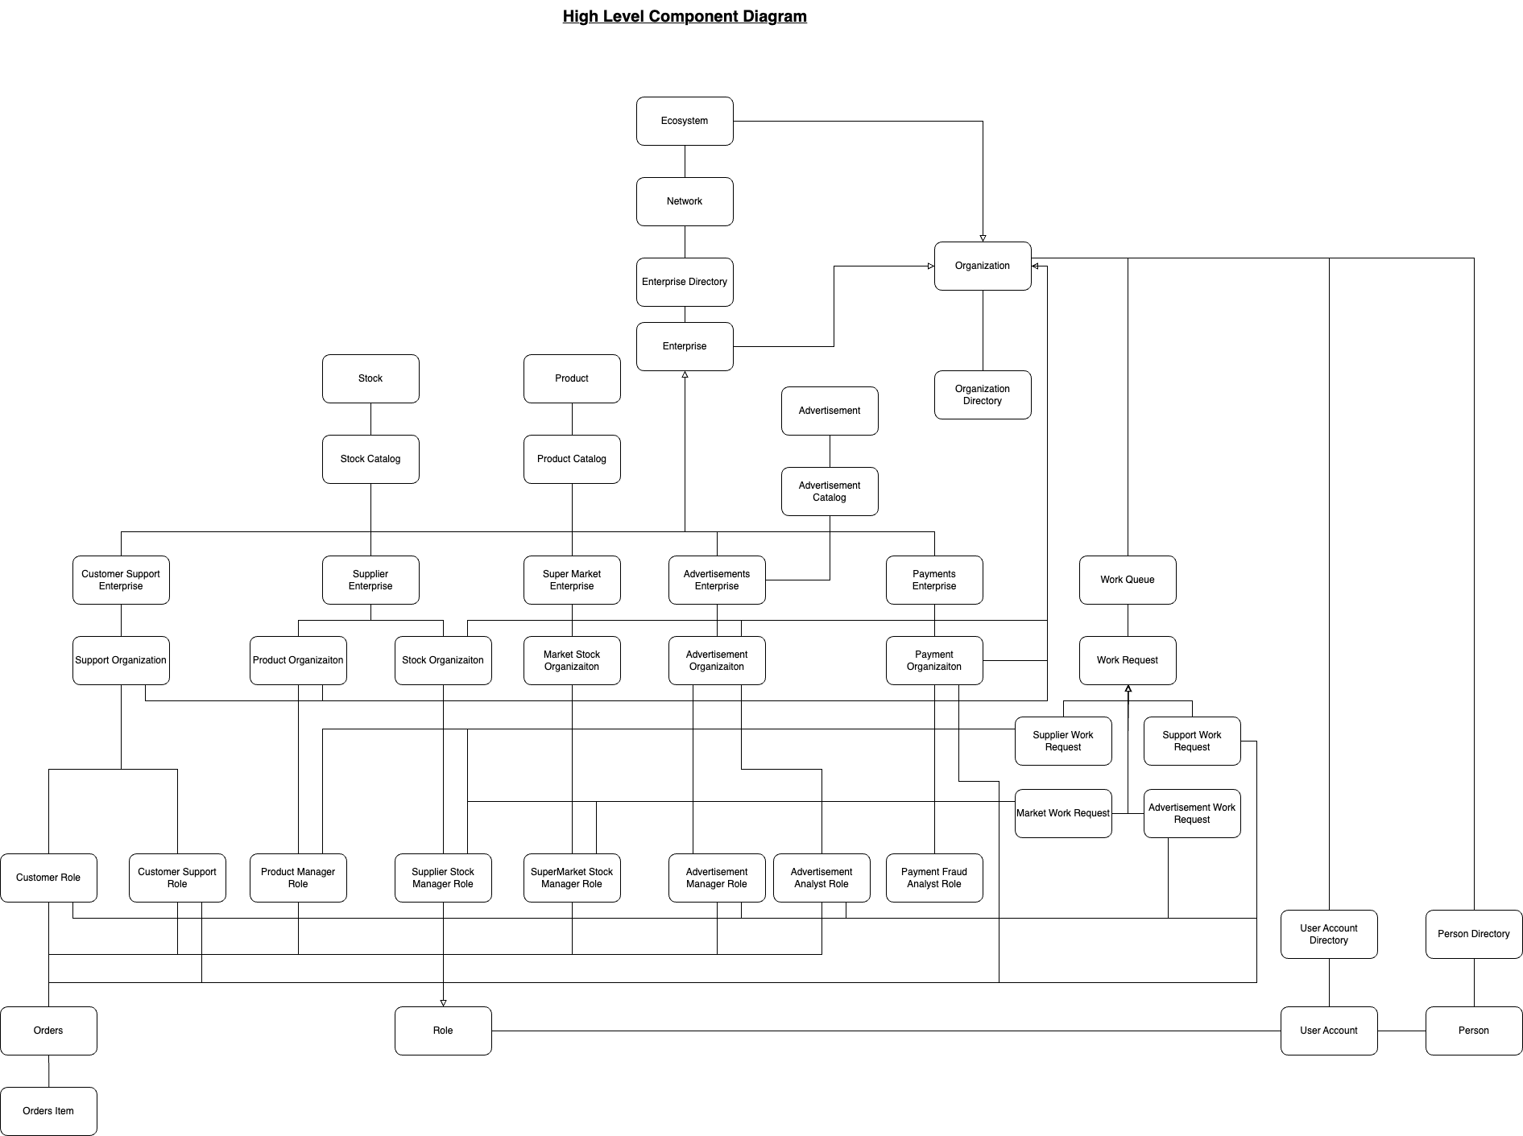
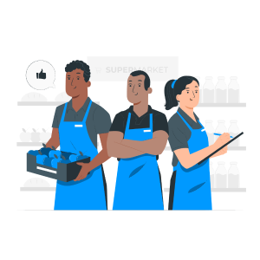
High Level Component Diagram

Slide 5
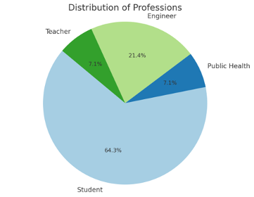
Survey Statistics
In a survey we conducted today:
50% of respondents shop once a week
28.6% shop twice a week
21.4% shop 2-3 times or more
12 out of 13 believe such a platform would be helpful.
11 out of 13 prefer a free platform, even with advertisements.

Slide 6


About Our Project
5 Enterprise Types
6 Organization Types
8 Major Roles (Apart from admins)
Many features (Mailer, APIs, Real Time clickstream data capture, etc)

Slide 7

Advanced Features
Our smart shopping feature automatically finds out the nearest stores where the product can be found for cheaper prices.
We currently are showing advertisements based on the user locations. Location based ad-targeting.
Mailer to send shipping confirmation.
Advertisements, payment fraud analysis to derive interesting statistics out of data.
1
2
3
4

Slide 8
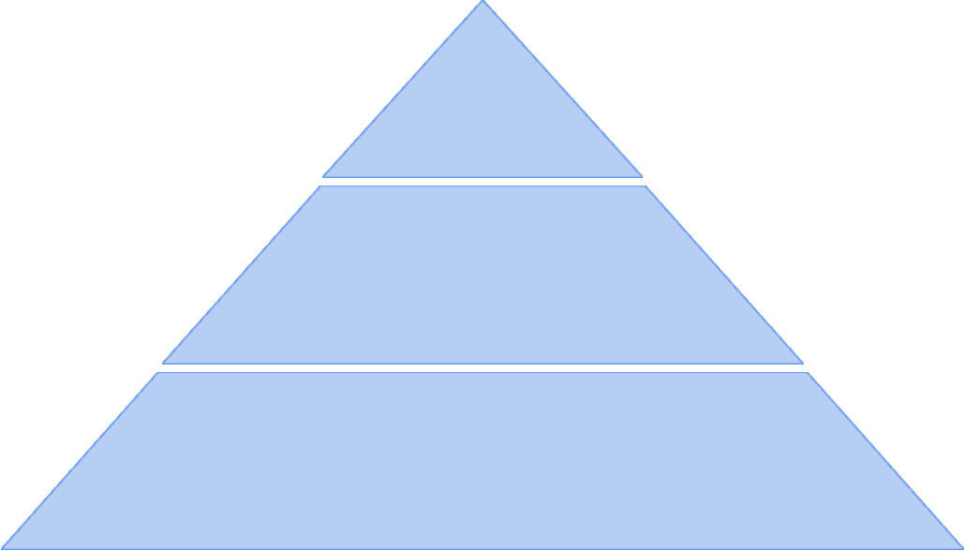
Future Scope
Order Based Ad Recommendations
We can use current order items in cart and recommend advertisements.
1
Left the Cart Mailer
Whenever a user leaves the cart without purchasing, we can mail them.
2
Location Based Product Pricing
Based on the user location, we can dynamically price the products.
3

Slide 9
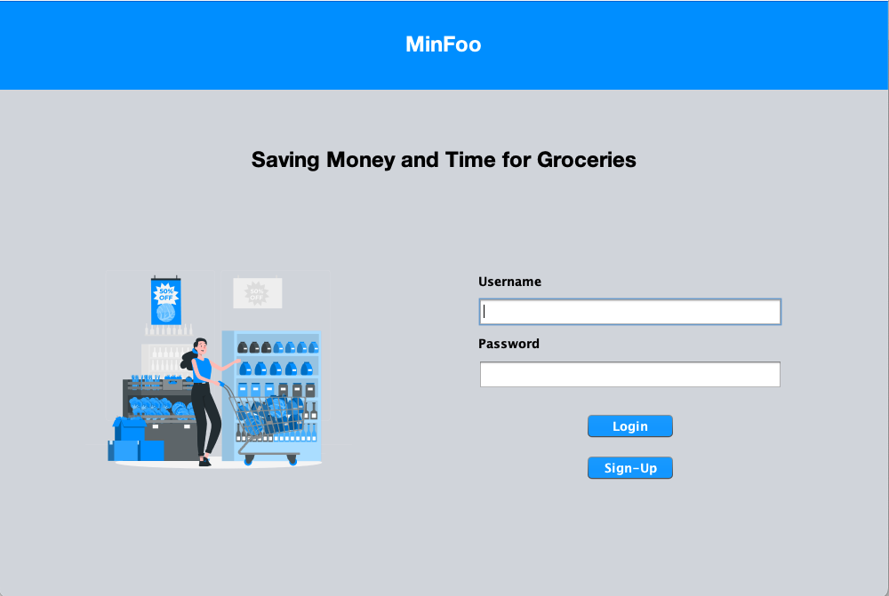
Demo

